Slide 1




EMERGENCY SHELTER KIT
The modular shelter design is a temporary, robust, panel-based structure that allows for easy extension to meet varying household space needs. The current design provides only living space that households can adapt to their needs.
It can be quickly dismantled and transported, making it suitable for temporary settings.
Installation of the 17 sq.m. shelter, which accommodates up to 5 people, typically takes around 1 day with one skilled and two unskilled workers. This shelter can also be constructed through a household-led approach. However, vulnerable households, especially those requiring physical assistance, may face challenges in self-installation. The design can be modified for different household needs.
This document was developed by:
Notes:
While the current design provides only the living space, its impact is maximized when complemented with distributions of non-food items (NFIs), WASH facilities, and designated cooking spaces.

Slide 2









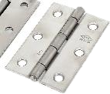

Emergency Shelter Kit – Essential Components
TIMBER BATTEN
Structural timber sections (5x 2.5cm x 2.4 m) rectangular shaped high quality free of knots-minimum density: 370 KG/cubic meter - untreated. C16 or C24 graded timber.
94 PCS
TARPAULINS
Tarpaulin sheet UNHCR/IFRC standard specs: standard size (4x6m); Woven high‐density polyethylene (HDPE) fabric laminated on both sides with low-density polyethylene (LDPE) coating White color
3 used for structure, 1 for flooring, 1 for internal partition
5 PCS
NAILS 50mm
Hot galvanised iron, for wood, 5cm (2'') Used for structural joints and fixing cover-battens.
2 KG
CLAW HAMMER
Claw Hammer - Weight: 0.45 kg. Fiberglass/metal handle, unbreakable. Head in forged steel. Good quality.
1 PCS
ROPE 6mm
Polypropylene, diam. 6mm,minimum 3 strands, twisted
30 M
SHOVEL
Head with sharpened tip in forged steel which is tempered and hardened. Supplied with a handle. Total length: 100 to 110 cm.(good quality)
1 PCS
HAND SAW
All-Purpose. Blade length of 500mm and an overall length of approx. 640mm. 8 or 9 TPI (teeth per inch), hardpoint teeth from tempered and hardened steel. Unbreakable handle and good saw blade.
2 PCS
MEASURING TAPE
3 meters, graduated in centimetres.
1 PCS
SCALPEL*
A cutting scalpel with blades , suitable for light and medium work. Easy to use
1 PCS
HINGES 75MM
Galvanized and rust resistant steel hinges suitable for timber window and door shutters. Hinges to be fixed with appropriate screws. (2 pairs for windows, 1 pair for door).
4 PAIRS
SCREWS
Galvanized wood screws, 35mm length, for securing hinges to timber frames. Screws to match hinge type.
NB: Hinges may come pre-packaged with their own screws
24 PCS
*Note: It is recommended that items such as scalpel, for which approvals are uncertain should be palletized separately

Slide 3





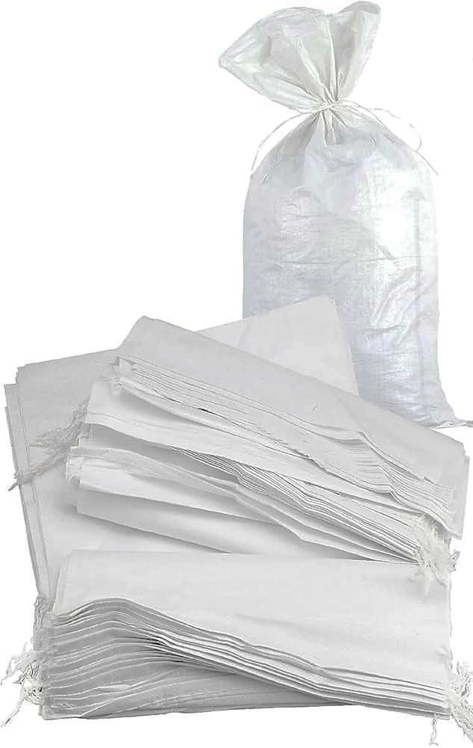

Emergency Shelter Kit – Maintenance Components
DUCT TAPE
Adhesive/duct tape of 25‐meter length, water resistance – Extra Heavy Duty, 50mm
2 ROLLS
PLIERS
Combination pliers 150mm, 34mm jaw
1 PCS
PLASTIC FILM
Plastic film 0.3mm thick, up to 50 sqm per shelter. Minimum width 4m
50 M²
BAG
Heavy water-resistant cotton canvas. Strong webbing handles and heavy-duty nylon zip for distribution of the items 50kg
1 PCS
ROPE 3mm
Polypropylene, diam. 3mm, minimum 3 strands, twisted
30 M
NEEDLE
Stitching, curved, 127mm x 1.8mm, hole 1x7mm
1 PCS
SANDBAGS*
Empty woven polypropylene (PP) or polyethylene fabric sacks, 50 cm x 80 cm, minimum 80 GSM. Holds approx. 25–30 kg of sand or soil
21 PCS/LAYER
TIE WIRE
Galvanised, diam. 1.5 mm, roll
1 ROLL
*Note: If it is not possible to procure sandbags, partners may coordinate with Food Security Cluster for access to flour sacks.

Slide 4
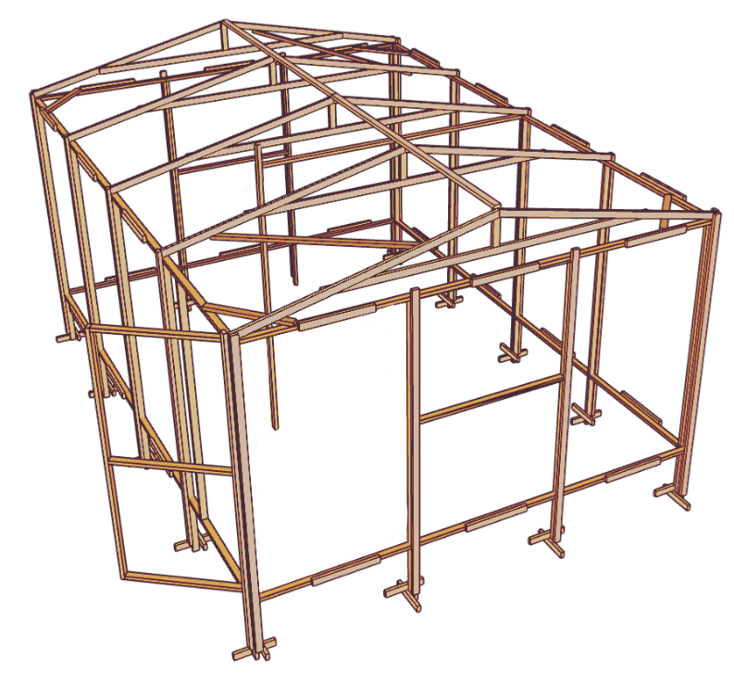


ESSENTIAL MATERIAL REQUIREMENTS
Shelter component | Timber quantity | Tarpaulin quantity
Walls | Panels: 54, Door: 3, Windows: 4, Securing tarp: 4, Corner braces: 1 | 2
Roof | Truss x5: 15, Ridge: 2, truss braces 1, Securing tarp: 10 | 1
Floor | — | 1
Partition | — | 1
TOTAL | 94 | 5
Number of nails: 2KG
2.4m Room Partition(x2)
60cm
60cm
60cm
60cm
Corner bracing, Door, Center or Rafter, Fixing Tarp, Anchoring
1.8m Truss: securing tarp
60cm Walls: sercuring tarp
1.9m Door Frame
50cm Walls: sercuring tarp
1.2m Window openings
1.2m Window openings

Slide 5
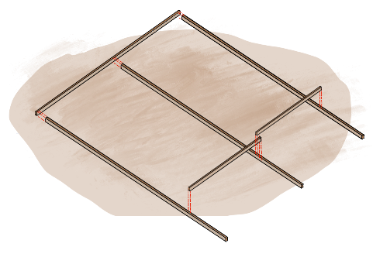
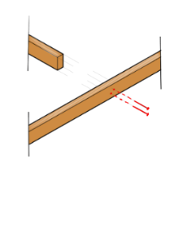
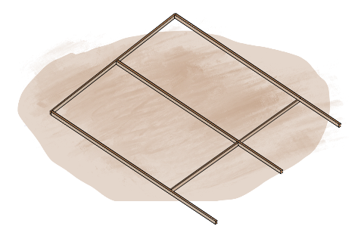
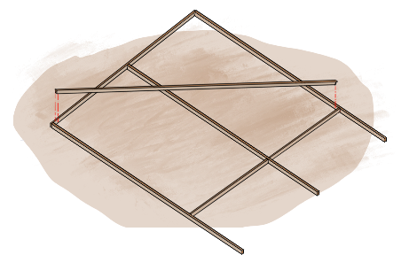
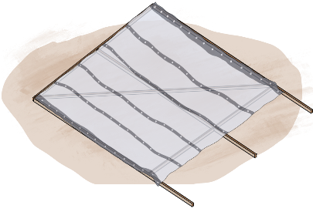
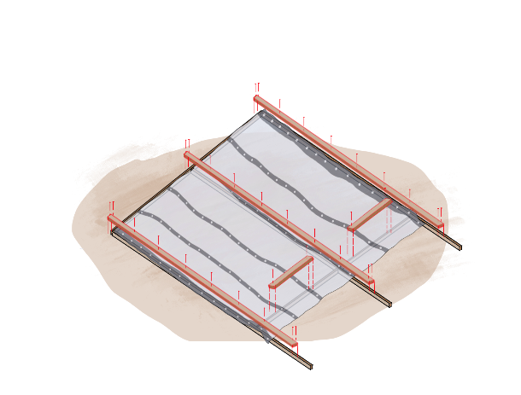
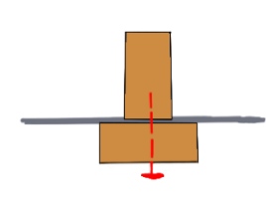
How to Build Wall Panels
Before starting to build your shelter, always clear the area of debris, rocks, and plants, and flatten the ground to create a stable and safe base.
a= 2.4 m
Thin edge = 2.5cm
a=2.4 m
//
a
5cm nails
//
//
a
30cm
//
a
1. Lay out the pieces of timber, standing them up on the thin edge. Nail the timber together using 5cm nails.
2. Check squareness by measuring both diagonals, measurements should be equal.
Temporary bracing
Flip it
30cm
3. Add temporary bracing (of any size) to hold the panel square, then flip it to fix the tarpaulin.
4. Lay tarpaulin over the frame, leaving 10cm below to prevent water entry and aid anchoring.
5cm nails
The frame is constructed as a ​T-section which makes it strong​.
2.4m long cover-batten
30 cm
10cm “skirting”
2.5cm
5cm
50cm long cover-batten
2.5cm
The tarpaulin should be pulled tight to keep the structure square, but not so tight that it bends the timber.
5. Fix tarpaulin with 5 cm nails through 2.4 m cover battens at 30 cm spacing, then add 50 cm horizontal battens over it.

Slide 6
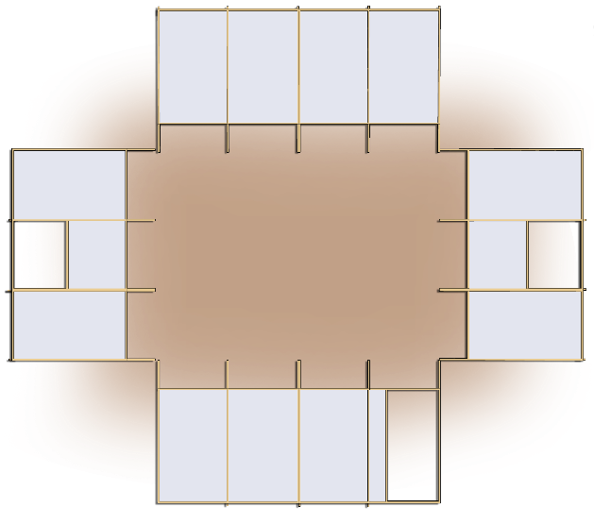
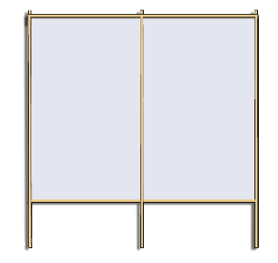
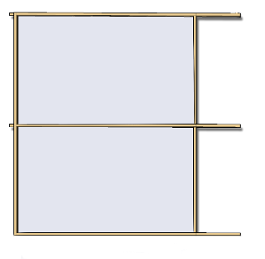
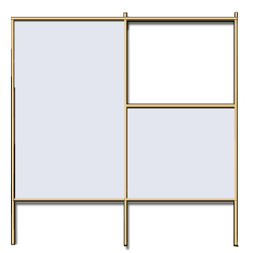

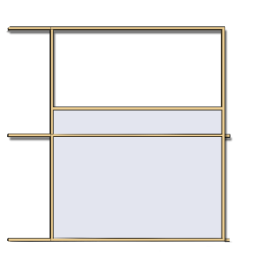
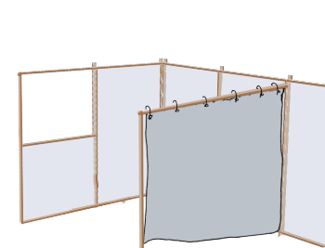
Wall Panels Details
4.8 m
Household size (# people)
5
Panel 1
Panel 2
Shelter size (m²)
4.8x3.6= 17.2m²
Panel 3
17.2 m²
Panel 3
3.6 m
Panel 4
Panel 4
Panel 1
Panel 5
Embed poles 30 cm deep, keep internal height at 2.1 m
Install door and window shutters with hinges and screws.
2.4 m
1.2 m
1.2 m
1.2 m
1.2 m
90cm
2.4 m
1.2m
Floor level
30cm
Panel 1 – 8 timbers
Panel 2 – 7 timbers
Panel 3 – Window panel* - 8 timbers
Window frame: 2 timbers
1.2 m
2.4 m
An internal movable partitions can be added using a tarpaulin
2.1 m
88cm
Floor level
30cm
Panel 4 – 4 timbers
Panel 5 – Door panel – 7 timbers
Door frame: 3 timbers
* Households are advised to choose door and window sizes and position based on their privacy and security needs.

Slide 7
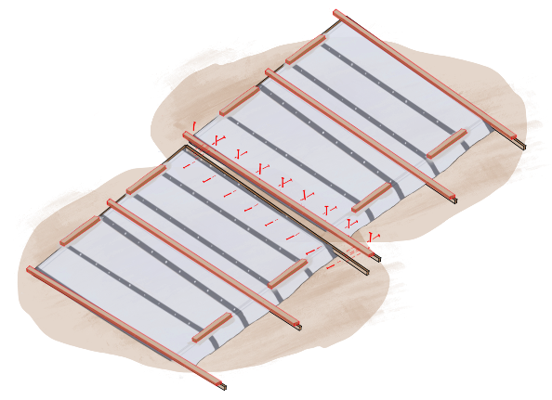
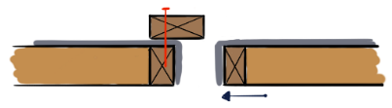
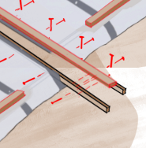

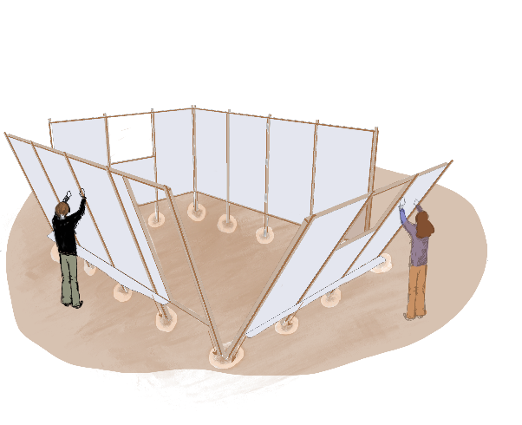
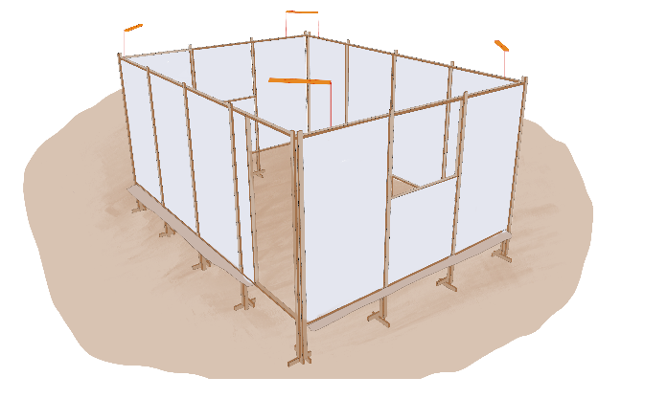

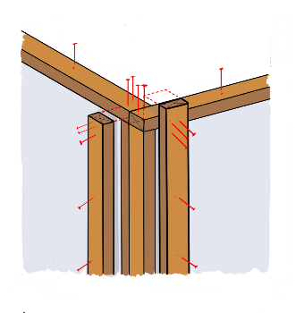
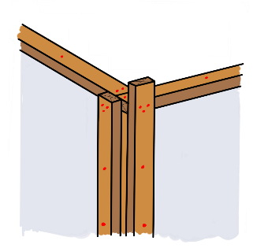
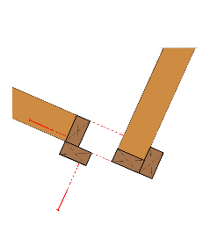
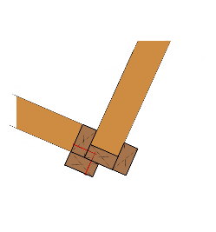
Wall Panels
Panel 1 cover-batten
5cm nail
Panel 1
Tarpaulin
Panel 1
Panel 2
Panel 2
A. Move Panel 2 closer to Panel 1
B. Connect the panels together by nailing the cover-batten
C. Nail the cover-batten timbers once the panels are lifted
Skirting = 10cm
5cm nails
Panel 1
Panel 2
Lift the panels together. Add corner bracing
Check if the shelter is square: measure both diagonals—they should match.
Add door and window frames*: a side-hinged door and two top-hung windows that serve as a canopy for privacy, weather and sun protection.
How is the corner joined together?
30 cm
Shelter Corner - Plan view
Connect the corners securely using 5cm nails
* Households can add mesh for insect protection and privacy. A canopy can be installed over doors to reduce water ingress.

Slide 8
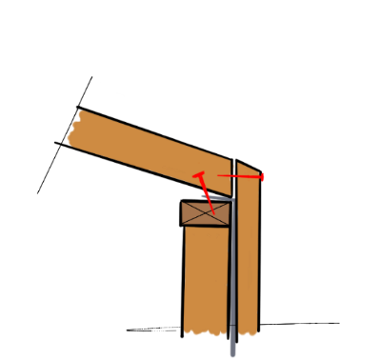
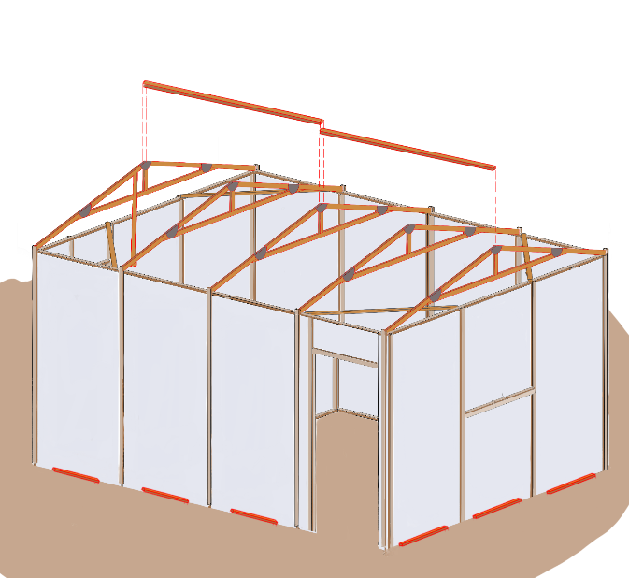
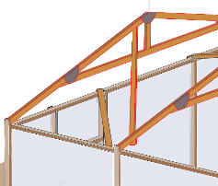

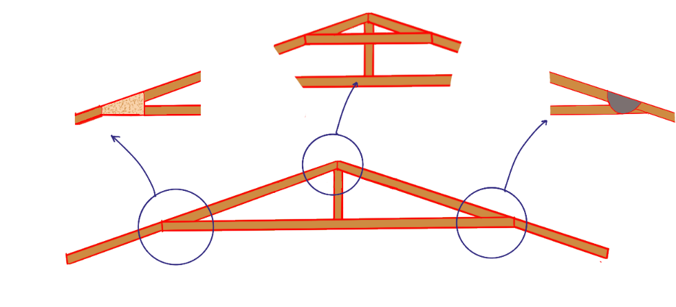
Pitched Roof
Use two 2.4 m lengths for the ridge beam.
They connect the trusses and support the tarpaulin.
Truss
5cm nails
2.4m
Tarpaulin
2.4m
Cover batten
Wall panel
Timber connection detail - 01
Fix diagonal braces at both ends, attach them to the underside of the first two and last two trusses.
Alternative 01:
OSB or plywood gusset plates for stronger joints
Alternative 02:
Horizontal pieces of timber are doubled, one on either side.
Alternative 03:
Used tin cans can make strong connections when OSB or plywood is unavailable
1.84 m
27cm
2.4m
14°
3.6m
To ensure uniformity and save time, construct all trusses simultaneously
by stacking them one on top of the other or using one as a template.
This approach guarantees that each truss is identical and reduces the risk of errors during the assembly process.

Slide 9
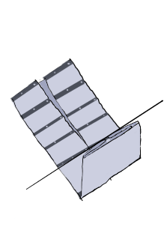
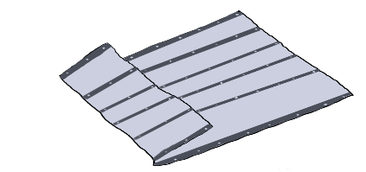
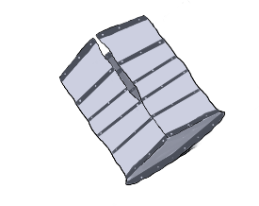
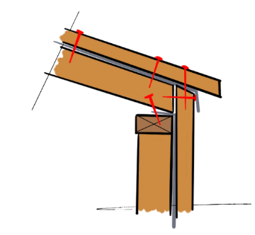
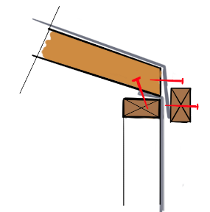
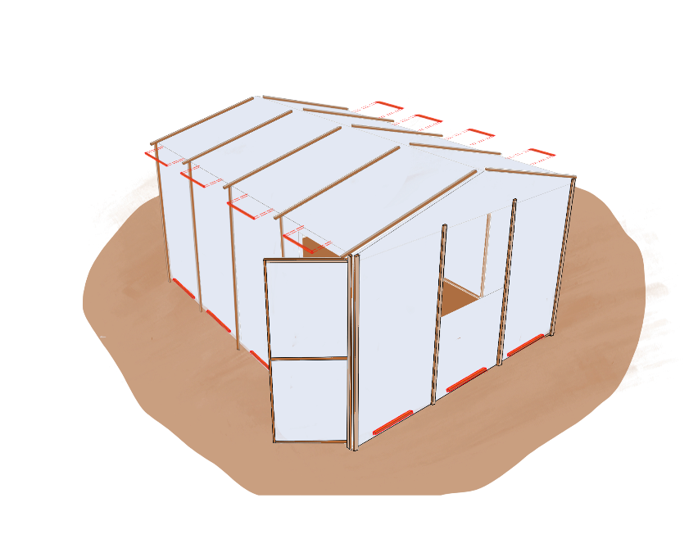
Pitched Roof Cover
1. Fold the Tarpaulin to facilitate its raising to the roof
First fold:
Fold the left-hand edge towards the centre line. Repeat for right-hand edge
Second fold:
Fold both sides again to the centre.
Third fold:
Fold top and bottom to the centre as shown.
2. Lift the folded tarpaulin on to the middle of the roof. Progressively unroll the tarpaulin over the roof structure.
3. Add timber cover battens to secure the tarpaulin to the trusses. Use the short off-cuts to nail tarp to the top of the walls.
30 cm
5cm nails
Roof cover batten
50-60cm off-cuts
Tarpaulin
Wall frame upper horizontal timber
Wall panel
Wall
cover batten
Timber connection detail - 02
Add 50-60 cm off-cuts to secure roof tarpaulin
Add a sloped canopy above the door to prevent rainwater entry. If there is space, extend the canopy sideways to create a sheltered cooking space

Slide 10
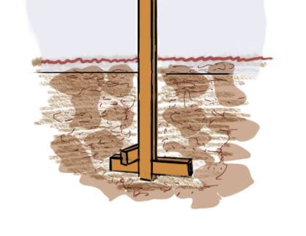
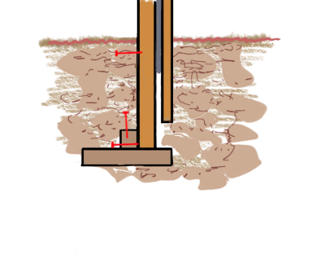
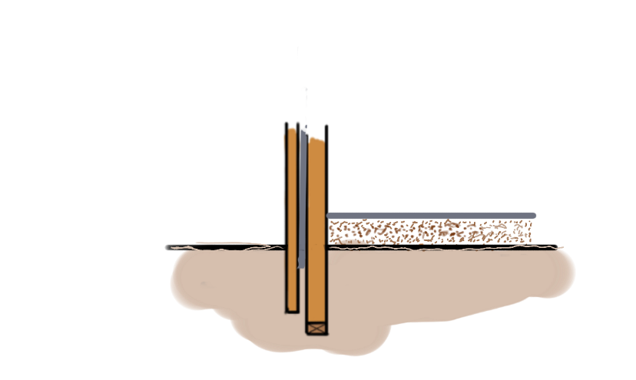
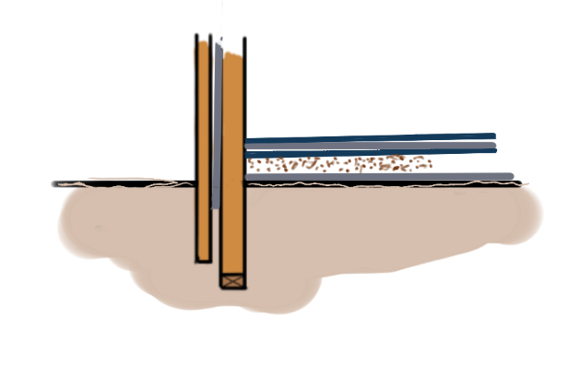
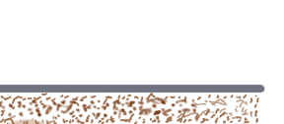
Raise the Shelter Floor
Flooring and Anchoring
Embed poles 30 cm deep. Bury tarpaulin edges 10 cm into the ground.
Tarpaulin
10 cm
30 cm
Raise the floor 20 cm with compacted sand and place sandbags around the perimeter to prevent water entry.
Tarpaulin: a damp-proof layer on your raised floor
OUTSIDE
Sand fill 20 cm
If materials are available, it is a good idea to have a raised floor inside the shelter that is kept dry and contained by a plastic sheet (a damp-proof membrane - DPM).
OUTSIDE
Floor Covering (Tarpaulin / Carpet, …)
Sand fill (20CM)
Plastic Sheet as Damp Proof Membrane (DPM)

Slide 11

Tarpaulin and Timber connection
WEAKER
Single nail
Standard nails will easily pull through tarpaulin as they have small heads
Standards nails can be improved by bending them or nailing them through folded tarpaulin or rope. U-shaped fencing staples can also be used.
Spread the Load
Standard nails can be improved using washers or bottle caps (sharp side away from tarpaulin) to spread the load. Alternatively domed head nails can be used.
Roof nail with rubber washer
Nail with
Bottle top
Nail with
Piece of wood
STRONGER
Using timber battening is very good for spreading the load.
Using a timber batten
Wrap around a timber batten
Tarpaulin should be folded over on itself at connection points.
As far as possible, the tarpaulin should be fixed along all edges to spread the load.
References: “Shelter Cluster website, Hurricane Beryl 2024 - Regional Response, Fixing tarpaulin” and “OXFAM Technical Brief – Plastic sheeting use and procurement in humanitarian relief”
The connections shown above also help seal nail heads by using folded tarpaulin, washers, bottle caps, small wood pieces, or timber battens—reducing the risk of roof leaks. When available, screws with rubber washers can also be considered for improved sealing.
Once good-quality tarpaulin is procured, it’s essential to fix it in a way that
Spreads the load,
Prevents flapping,
Avoids friction points,
Limits heat buildup.
To avoid tearing, fixings should be distributed over a wide area.
HELPFUL TIP

Slide 12
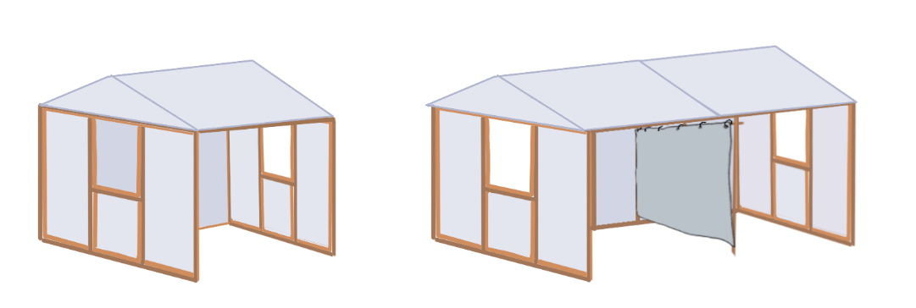

Modular Shelter Extensions for Adaptable Space Needs
The modular design of the shelter enables easy extension to accommodate households of varying size.
To avoid weakening the structure, the shelter width should not exceed 3.6 m, while the length can be adjusted as needed.
In the following section, we will explore adaptable models that allow for incremental extensions using the same panel system described on page 5.
3.6 m
3.6 m
3.6 m
7.2 m
Household Size* | 3-4 people | 6-7 people
Shelter size | 3.6x3.6= 13 m² | 7.2x3.6= 26 m²

Slide 13
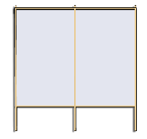


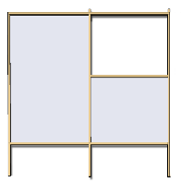


Household size (# people) | Shelter size (m²)
3 | 3.6x3.6= 13 m²
4
3.6 m
Panel 1
Panel 4
Panel 3
13 m²
Panel 3
3.6 m
Panel 4
Panel 4
Panel 4
Panel 5
ESSENTIAL MATERIAL REQUIREMENTS
Shelter component | Timber quantity | Tarpaulin quantity
Walls | Panels: 47, Door: 3, Windows: 4, Securing wall tarp: 3, Corner braces: 1 | 2
Roof | Truss x4: 12, Ridge: 1.5, truss braces: 1, Securing roof tarp: 8 | 1
Floor | — | 1
Partition | — | 1
TOTAL | 81 | 5
Number of nails: 2KG
* Households are advised to choose door and window sizes and position based on their privacy and security needs.

Slide 14
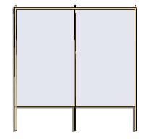


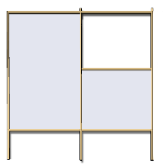
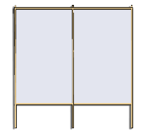
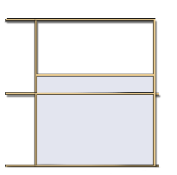
Household size (# people) | Shelter size (m²)
6 | 7.2x3.6= 26 m²
7
7.2 m
Panel 1
Panel 2
Panel 2
Panel 3
26 m²
Panel 3
3.6 m
Panel 4
Panel 4
Panel 1
Panel 2
Panel 5
ESSENTIAL MATERIAL REQUIREMENTS
Shelter component | Timber quantity | Tarpaulin quantity
Walls | Panels: 68, Door: 3, Windows: 4, Securing wall tarp: 6, Corner braces: 1 | 2
Roof | Trussx7 21, Ridge: 3, truss braces: 1, Securing roof tarp: 14 | 2
Floor | — | 2
Partition | — | 1
TOTAL | 121 | 7
Number of nails: 2.5KG
* Households are advised to choose door and window sizes and position based on their privacy and security needs.

